Slide 1


e - VOTING APPLICATION
Presented By : -
1. SAIFUL ISLAM
2. SUMIT GHOSH
3. AZIZ BARMAN

Slide 2

Outline of the presentation
1. About
2. Problem and Solution
3. Why e-voting?
4.Technology used to design
5. Data Flow Diagram
6. MVC Architecture
7. Conclusion

Slide 3
ABOUT
e – Voting refers to computerized machines that use electronic ballots rather than paper ones .
In this application students can cast their vote through a digital system.

Slide 4
PROBLEM and SOLUTION
Considering the real world problem, we wanted to develop a software for the department which will be a help for the department in the voting process (for selection of Department Representative and Department Secretary) from casting to calculating vote's and then selecting the candidate with higher number of vote's.
So we came across the idea of e - Voting to solve the problem.

Slide 5
Why e – voting over manual voting?
Eligibility and Authentication
Uniqueness
Accuracy
Secrecy
Conveinent
Reduce human labour

Slide 6
Technology used to Design Our Application
For Desktop Application:
JAVA -
IDE Used:IntelliJ IDEA
JDBC for java Database Connectivity
Database Management:phpMyAdmin

Slide 7
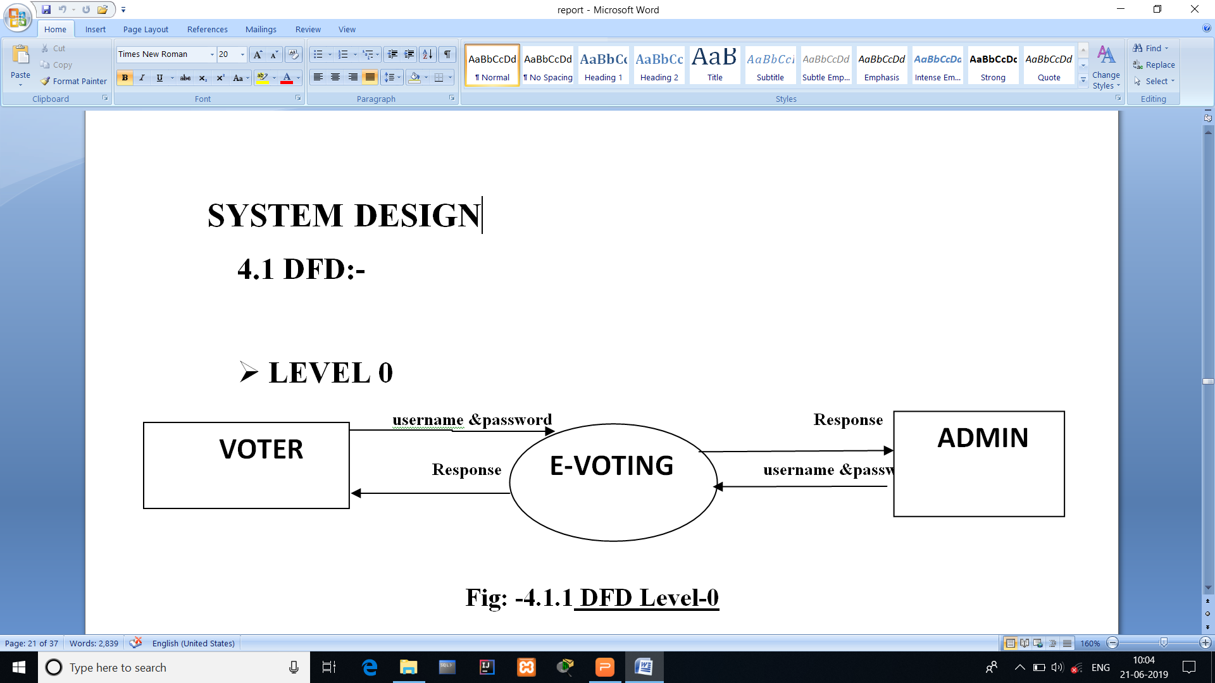
Data Flow Diagram
DFD - 0

Slide 8
MVC ARCHITECTURE
MODEL
CONTROLLER
VIEW

Slide 9
Conclusion
With E-voting we can decrease the man power,military movement for security purpose,transport expenses,counting time and most importantly we can save lots and lots of time .
However initial cost of installation and cyber threats are some of the disadvantages of E-voting.
so Finally we would like to conclude Break the line And enter Online.

Slide 10
References
Books
Pressman R.S 1997 Software Engineering -A practionary
approach 4th edition McGraw Hill International
Sites:
https://stackoverflow.com/questions/22345664/scene-builder
https://docs.oracle.com/javfx/2/ui_controls/table-view.htm

Slide 11
THANK YOU

